Slide 1
Time Management
Shruti Verma

Slide 2
Time Management Perception

Slide 3
Introduction
“Time is money,” as we have all heard. While time is valuable, it does not appear to be something we can grasp. And, despite the fact that we are all aware of the importance of cherishing our time, we unconsciously waste it at the tip of our fingers all the time! It’s as if we’re still grappling with the concept of time and how it works. Time management, on the other hand, has become a cultural obsession, and it, like any cultural phenomenon, is surrounded by myths.
With a limited understanding of time and these myths, it becomes increasingly difficult to use our time wisely and be truly productive. These misconceptions cause us to have a distorted view of productivity, causing us to become less efficient, less motivated, more prone to burnout, and more prone to making poor decisions.
To overcome some of these false beliefs, we must first understand what “time” means in terms of productivity.

Slide 4
Student Opinion about Time Management
Time management is nothing but common sense. I do well in school, so I must be managing my time effectively.
It takes all the fun out of life!!!
Time management? I work better under pressure.
No matter what I do, I won’t have enough time!

Slide 5
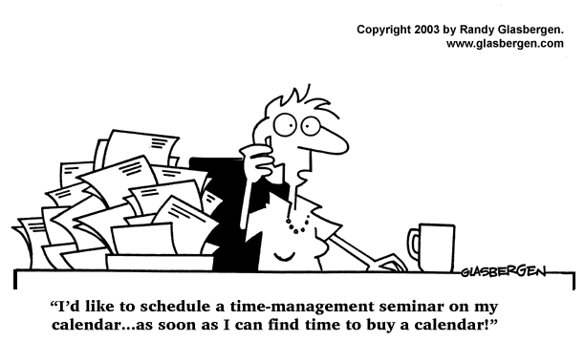

Slide 6
Time Management Perceptions and Myths
Misconception 1. All Time Is Equal.
If a person engages in activities that do not align with their values or goals on a consistent basis, they may be unaware that they are wasting valuable time that could be spent on more fulfilling and meaningful pursuits. In truth, some times are more important than others, and how we use our time has a significant impact on our lives. For example, time spent with loved ones or taking care of our physical and emotional health is more important than time spent on social media or watching television.
Misconception 2. Time Is Intangible
While time cannot be seen or touched in the same way that money or objects can, it remains a palpable and precious resource. Its worth is determined by its quality rather than by a specific amount or quantity. The value of time is measured by its quality.

Slide 7
Time Management Perceptions and Myths
Misconception 3. More Time Equals More Productivity.
It is not how much time you have, but how you use it. People who use their time efficiently can be just as productive in less time. There is also such a thing as too much time. When a person has too much time on their hands, they may become less motivated or focused, and they may even procrastinate. It’s more important to strike a balance and use time wisely than to simply try to complete more tasks in less time.
Misconception 4. Time Management Is About Doing More.
If you try to do too much and overburden yourself with work, you may experience burnout, which can lead to decreased productivity and overall well-being. This is why it’s crucial to schedule downtime and activities that bring you joy and relaxation. Finding balance between your personal, professional, and recreational pursuits is a key component of time management.

Slide 8
Time Management Perceptions and Myths
Misconception 5. To Be Productive, You Must Do Everything Yourself.
Attempting to do everything yourself can reduce your productivity over time. Delegating tasks to others can help you save time and focus on the most important tasks. It is an efficient method of utilizing the strengths and skills of others. Delegating tasks to people who are skilled in a particular area may allow them to complete the task more efficiently and effectively than if you tried to do it yourself. Overall, delegating tasks can be a good way to boost productivity and efficiency if done correctly.
Misconception 6. Controlling Your Calendar Is Impossible If You Aren’t the Boss.
Many people believe that if they are not the boss, they will be unable to control their calendar due to their limited decision-making power. They may have less decision-making power and may not be able to control when meetings are scheduled and tasks are assigned.
While controlling your calendar may be more challenging if you are not the boss, it is still possible to manage your time effectively.

Slide 9
Time Management Perceptions and Myths
Misconception 7. It’s Good To Be Constantly Busy.
Being overly busy can result in burnout and a decline in productivity. It can be difficult to focus and complete tasks when you are overwhelmed and overburdened. Therefore, it’s important to schedule breaks and downtime so you can recharge.
Misconception 8. Time Management Is A One-Time Fix.
It’s also important to review and adjust your time management strategies on a regular basis, as many factors can affect your ability to manage your time effectively, such as changes in your work or personal commitments, changes in your goals and priorities, and changes in your workload.
Remember, time management is an ongoing process that needs constant effort and attention to be successful.

Slide 10
Additional Thoughts
Misconceptions of time can lead to unrealistic expectations and perspectives on time, preventing people from making the best use of their time. Furthermore, misconceptions about time management can lead to inefficient time management. People who believe they must work nonstop in order to be productive may be wasting their time..
Understanding time management myths can help you use your time more effectively and efficiently, as well as have a more positive attitude toward time management.

Slide 11
The Truth About Time Management
Increases productivity.
Reduces stress.
Improves self-esteem.
Helps achieve balance in life.
Increases self-confidence
Helps you reach your goals!

Slide 12
Time management:
How it influences your life

Slide 13
Benefits of Time Management
The ability to manage your time effectively is important. Good time management leads to improved efficiency and productivity, less stress, and more success in life. Here are some benefits of managing time effectively:
1. Stress relief
Making and following a task schedule reduces anxiety. As you check off items on your “to-do” list, you can see that you are making tangible progress. This helps you avoid feeling stressed out with worry about whether you’re getting things done.
2. More time
Good time management gives you extra time to spend in your daily life. People who can time-manage effectively enjoy having more time to spend on hobbies or other personal pursuits.

Slide 14
Benefits of Time Management
3. More opportunities
Managing time well leads to more opportunities and less time wasted on trivial activities. Good time management skills are key qualities that employers look for. The ability to prioritize and schedule work is extremely desirable for any organization.
4. Ability to realize goals
Individuals who practice good time management are able to better achieve goals and objectives, and do so in a shorter length of time.

Slide 15
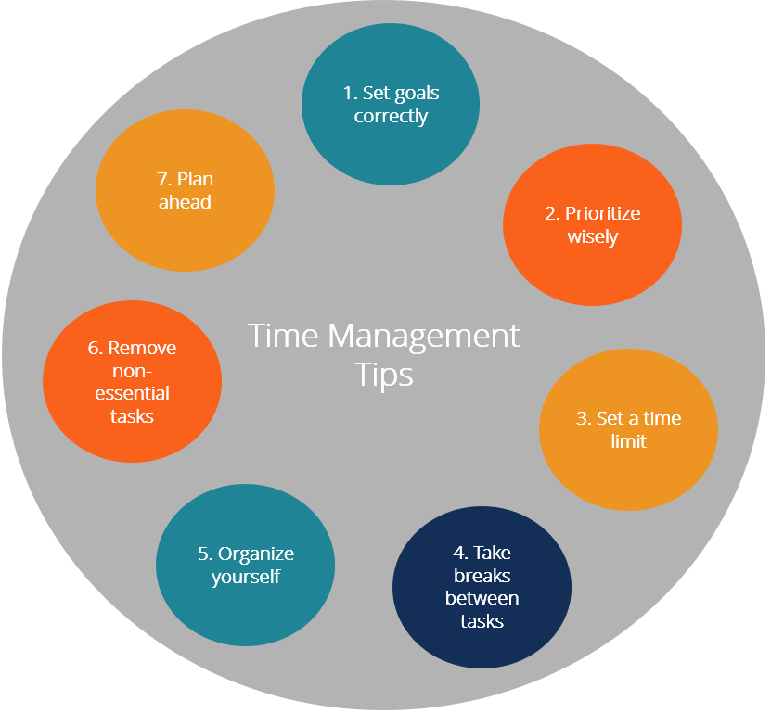
How to manage time?

Slide 16
How to manage time?
1. Set goals correctly
Set goals that are achievable and measurable. Use the SMART method when setting goals. In essence, make sure the goals you set are Specific, Measurable, Attainable, Relevant, and Timely.
2. Prioritize wisely
Prioritize tasks based on importance and urgency. For example, look at your daily tasks and determine which are:
Important and urgent: Do these tasks right away.
Important but not urgent: Decide when to do these tasks.
Urgent but not important: Delegate these tasks if possible.
Not urgent and not important: Set these aside to do later.

Slide 17
How to manage time?
3. Set a time limit to complete a task
Setting time constraints for completing tasks helps you be more focused and efficient. Making the small extra effort to decide on how much time you need to allot for each task can also help you recognize potential problems before they arise. That way you can make plans for dealing with them.
For example, assume you need to write up five reviews in time for a meeting. However, you realize that you’ll only be able to get four of them done in the time remaining before the meeting. If you become aware of this fact well in advance, you may be able to easily delegate writing up one of the reviews to someone else. However, if you hadn’t bothered to do a time check on your tasks beforehand, you might have ended up not realizing your time problem until just an hour before the meeting. At that point, it might be considerably more difficult to find someone to delegate one of the reviews to, and more difficult for them to fit the task into their day, too.

Slide 18
How to manage time?
4. Take a break between tasks
When doing a lot of tasks without a break, it is harder to stay focused and motivated. Allow some downtime between tasks to clear your head and refresh yourself. Consider grabbing a brief nap, going for a short walk, or meditating.
5. Organize yourself
Utilize your calendar for more long-term time management. Write down the deadlines for projects, or for tasks that are part of completing the overall project. Think about which days might be best to dedicate to specific tasks. For example, you might need to plan a meeting to discuss cash flow on a day when you know the company CFO is available.

Slide 19
How to manage time?
6. Remove non-essential tasks/activities
It is important to remove excess activities or tasks. Determine what is significant and what deserves your time. Removing non-essential tasks/activities frees up more of your time to be spent on genuinely important things.
7. Plan ahead
Make sure you start every day with a clear idea of what you need to do – what needs to get done THAT DAY. Consider making it a habit to, at the end of each workday, go ahead and write out your “to-do” list for the next workday. That way you can hit the ground running the next morning.

Slide 20
Implications of Poor Time Management
1. Poor workflow
The inability to plan ahead and stick to goals means poor efficiency. For example, if there are several important study tasks to complete, an effective plan would be to complete related tasks together or sequentially. However, if you don’t plan ahead, you could end up having to jump back and forth, or backtrack, in doing your work. That translates to reduced efficiency and lower productivity.

Slide 21
Implications of Poor Time Management
2. Wasted time
Poor time management results in wasted time. For example, by talking to friends on social media while doing an assignment, you are distracting yourself and wasting time.
3. Loss of control
By not knowing what the next task is, you suffer from loss of control of your life. That can contribute to higher stress levels and anxiety.

Slide 22
Implications of Poor Time Management
4. Poor quality of work
Poor time management typically makes the quality of your work suffer. For example, having to rush to complete tasks at the last minute usually compromises quality.
5. Poor reputation
If clients or your employer cannot rely on you to complete tasks in a timely manner, their expectations and perceptions of you are adversely affected. If a client cannot rely on you to get something done on time, they will likely take their business elsewhere.

Slide 23
Prioritisation

Slide 24
What is Prioritizing?
As a principle, it means doing 'first things first;' as a process, it means evaluating a group of items and ranking them in their order of importance or urgency.
The trick is to identify which task is important to accomplish and which task is urgent.
We believe we’re getting things done just by being busy. The truth is that busy tends to stack up more and more work. Worse, without a thoughtful plan of attack, we can let truly important tasks go undone until they become a crisis forcing us to drop everything else and ‘put out the fire’ in panic mode.

Slide 25
How to Prioritize Effectively
Three-step approach when you are first beginning to prioritize:
1. know what your work actually consists of and make a list (including deadlines),
2. break down your list into three types of work — single tasks, recurring tasks, and projects, and
3. prioritize only the urgent deadline driven work at first, until you get a handle on things and things are running more smoothly.

Slide 26
When and What to Prioritize
Take a look at all the tasks you’re doing and review the importance of each of them. Specifically, measure a task’s importance by its cost and benefit.
Cost- the effort needed per task (including time, money, and other resources).
Benefit- how closely the task can contribute to your goal.

Slide 27
Low cost + High benefit. Do these tasks first because they’re the simple ones to complete, yet help you get closer to your goal. High cost + High benefit. Break the high cost task down into smaller ones. In other words, break the big task into mini ones that take less than an hour to complete. And then re-evaluate these small tasks and set their correct priority level. Low cost + Low benefit. This combination should be your lowest priority. Either give yourself 10-15 minutes to handle this task or put these kind of tasks in between valuable tasks as a useful break. These are probably necessary tasks (e.g., routine tasks like checking emails) but they don’t contribute much towards reaching your desired goal. Keep them way down your priority list. High cost + Low benefit. Review if these tasks are really necessary. Think of ways to reduce the cost if you decide that the completion of the task is required.

Slide 28
The Benefits of Prioritizing
1. It reduces stress and increases productivity. “Knowing that you don’t have to finish all tasks at once, or in a single day will give you a more flexible time to focus on the most important things first.” 2. It helps you create room to check your errors. “Task prioritization ensures that you allocate sufficient time to complete tasks and also make necessary changes in order to save time and become more productive.” 3. It gives you more time to relax. “When you complete your scheduled tasks ahead of the time allocated, you have sufficient time to relax and recharge your body for future tasks. You may even allocate breaks in-between your tasks.” 4. It helps you avoid procrastination. “Procrastination is the number one hindrance to productivity… because it forces you to waste your time…” 5. It keeps you motivated. “When you prioritize your tasks and see positive results, you will become motivated to handle even more tasks…”

Slide 29
Magic of 168 hours

Slide 30
Problem of No time
How many times have you recently thought “I wish the day had more than 24 hours”. Well, that simple idea may be just the root cause of your time problems!
Think of the typical day of an executive: 8-10 hours working, 1-2 commuting, 1-2 feeding, 1-2 household and hygiene, 1-2 for family, friends, and personal activities and 6-8-hour sleep. The day is over. Wake up and repeat!
Do not think it is your fault. Most (probably all) of us have been grown that way. And it means that our thought process is extremely biased in this direction since we were kids.

Slide 31
Magic of 168
However, the good news is you can change it by simply using the magic number 168. Instead of thinking in a 24-hour daily window, start thinking of a 168-hour weekly window.
In 168 Hours, Laura Vanderkam argues that most people have enough time for everything they need and want to do. The problem is that people are not using their time intentionally. Drawing on her experience, she explains how we can be more intentional with our time at work, at home, and with our leisure.

Slide 32
Being intentional with time
Vanderkam explains that when you’re intentional with your time, you do three things
First, you actively schedule your week around your priorities.
Second, you understand your “core competencies,” or unique strengths—the things that you’re amazing at or can’t outsource—and spend most of the week using these strengths while delegating tasks that you don’t excel at.
Third, you understand that you choose how to spend your time. If you don’t do a task, it’s not because you lacked time but because you didn’t want to do it. By doing these three things, she contends you can live a full, meaningful life.

Slide 33
Step 1- Start by Listing Everything You Care About
list out everything you care about in one column of a spreadsheet. Work, friends, family, projects, hobbies, and so on. Whatever you want to spend time on all month long.
Then subtract 7 hours from the 168 for “lost time” like using the bathroom, walking to car from office or home, and little things like that we can’t account for in the time schedule.

Slide 34
Step 2. Assign the Time You Want to Each Activity
Assign time to each activity. Start with the things that matter to you most and then add time around those. Time for family and time for studies take primary importance in the life of students

Slide 35
Step 3 Create a Strategy
After you see the hours left to work with, do one of two things:
Create time slots during the day for each activity and set an alarm across the room to help me stop and start activities at the right time OR
Create a day focused around one or two focus activities

Slide 36
Algorithm of 168 hours technique
Write down ALL your activities, including both what you already do and what you would love to get started. You can use the building blocks mentioned above or add other ones.
Plan your full next week, including the weekend, and allocate time for every activity. How long do you plan to dedicate to each item?
Check how much time you have left – there should still be hours available in your “wallet of time”
If you are in negative credit, go back to step 2 and revisit the time allocation. Where can you cut? Please do not do it in the usual suspects!
Stick to your plan. Of course, there must be room for flexibility, but for the most part you must be able to keep your commitments

Slide 37
Benefits
You will find out where you are losing or even wasting time in non-productive activities or “time suckers” and reallocate that time to what you really love to do.
You will reduce your stress level in times of high workload or long business trips by simply thinking that you have it all under control and will compensate it later with the pre-allocated time.

Slide 38
S.M.A.R.T Time Management

Slide 39
SMART
SMART Goals For Time Management is important to ensure you know what you want to achieve by managing your time.
More importantly, setting SMART goals increases its chances for accomplishment or success a hundredfold.
When you set a SMART goal for your time management strategies, ie. having a specific goal within a given reasonable time frame that is also measurable, you tend to get better results.
So anyone with time management aspirations can apply this guide to direct their plan through actionable steps using the SMART goals.

Slide 40
What Is A SMART Goal?
SMART is an acronym that stands for Specific, Measurable, Attainable, Relevant, and Time-based. A SMART goal simply means that you are optimizing your goals on the basis of these given five parameters.
Specific: Your goal needs to be well-defined, detailed, and precise. It must focus specifically on a particular area in a certain direction.
Measurable: Your goal must be quantifiable and can be measured with facts, figures or etc., to determine your progress throughout the duration of the goal.
Attainable: The goal you set must be realistic, and you should have reasonable means, resources, and time to achieve it, along with relevant skills.
Relevant: You also check the relevancy of the goal, which means it must be signed in your life, and you can define its implications or results.
Time-based: The goal you set must be time-based, i.e., restrained within a time limit or has a specific deadline to finish the goal.

Slide 41
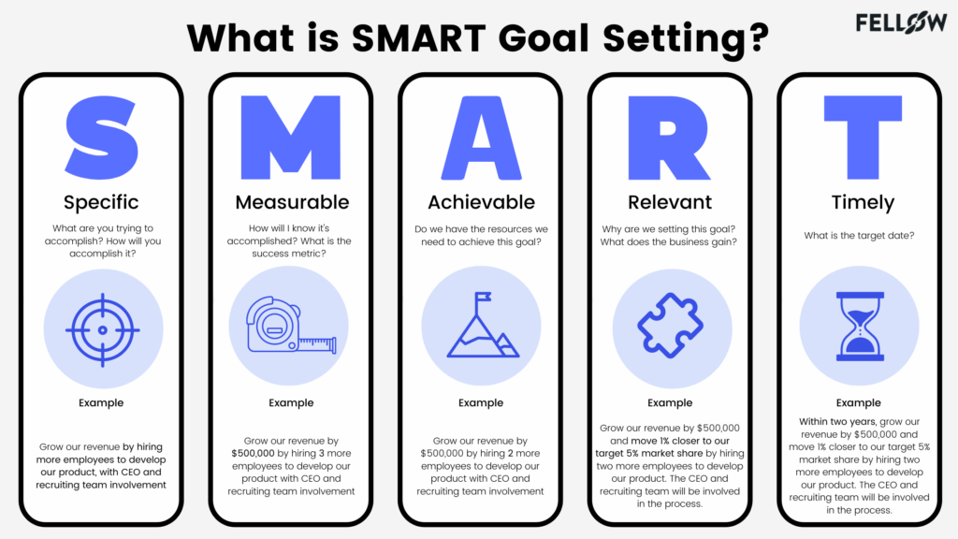

Slide 42
Benefits of SMART Time Management
You will have a defined deadline to achieve your time management goals.
You will become more productive and efficient.
You will be able to track the progress of your time management goals throughout the journey or process.
You will have more time to focus on other goals.
You will be able to become proactive and avoid procrastination.

Slide 43
Time Management Tools

Slide 44
Time Management Tools
There are a lot of time management tools out there. Here are some simple to use time management tools:
To-do list
Time Schedule
Action Priority Matrix
Urgent/Important Matrix
Interruptions Log
Pomodoro Technique
Task Breakdown

Slide 45
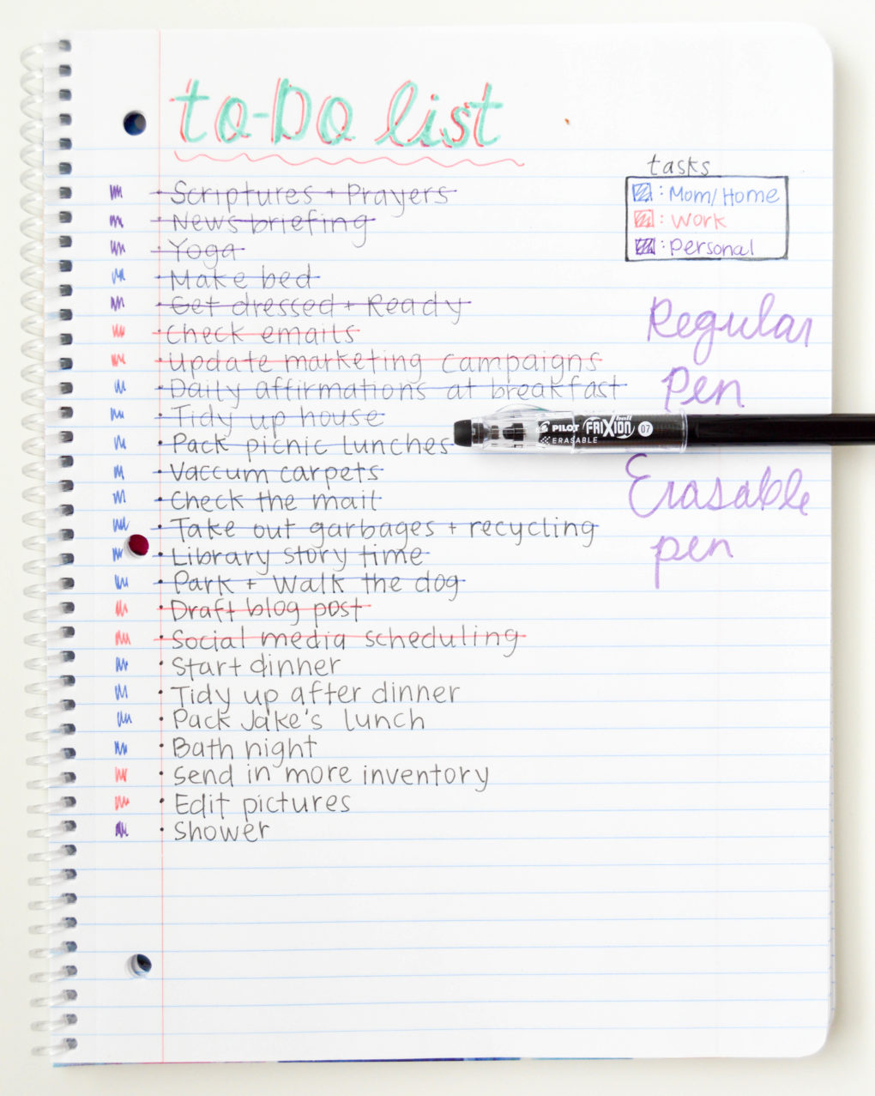
To-do Lists
The idea of a to-do list is to get everything that you need out of your head and captured somewhere. This gives you a great oversight of everything that you need to get done.
The benefit of using a to-do list means that you shouldn’t forget anything (providing of course you remember to write it on your list).
To-do lists do have some downsides.-
1. the list just becomes a list of things written on a sheet of paper that doesn’t necessarily drive any kind of action.
2. To-do lists can lead to overwhelm. When the list is large, we can become guilty of just staring at it and wondering where we should start. This means the list creates inaction rather than action.

Slide 46
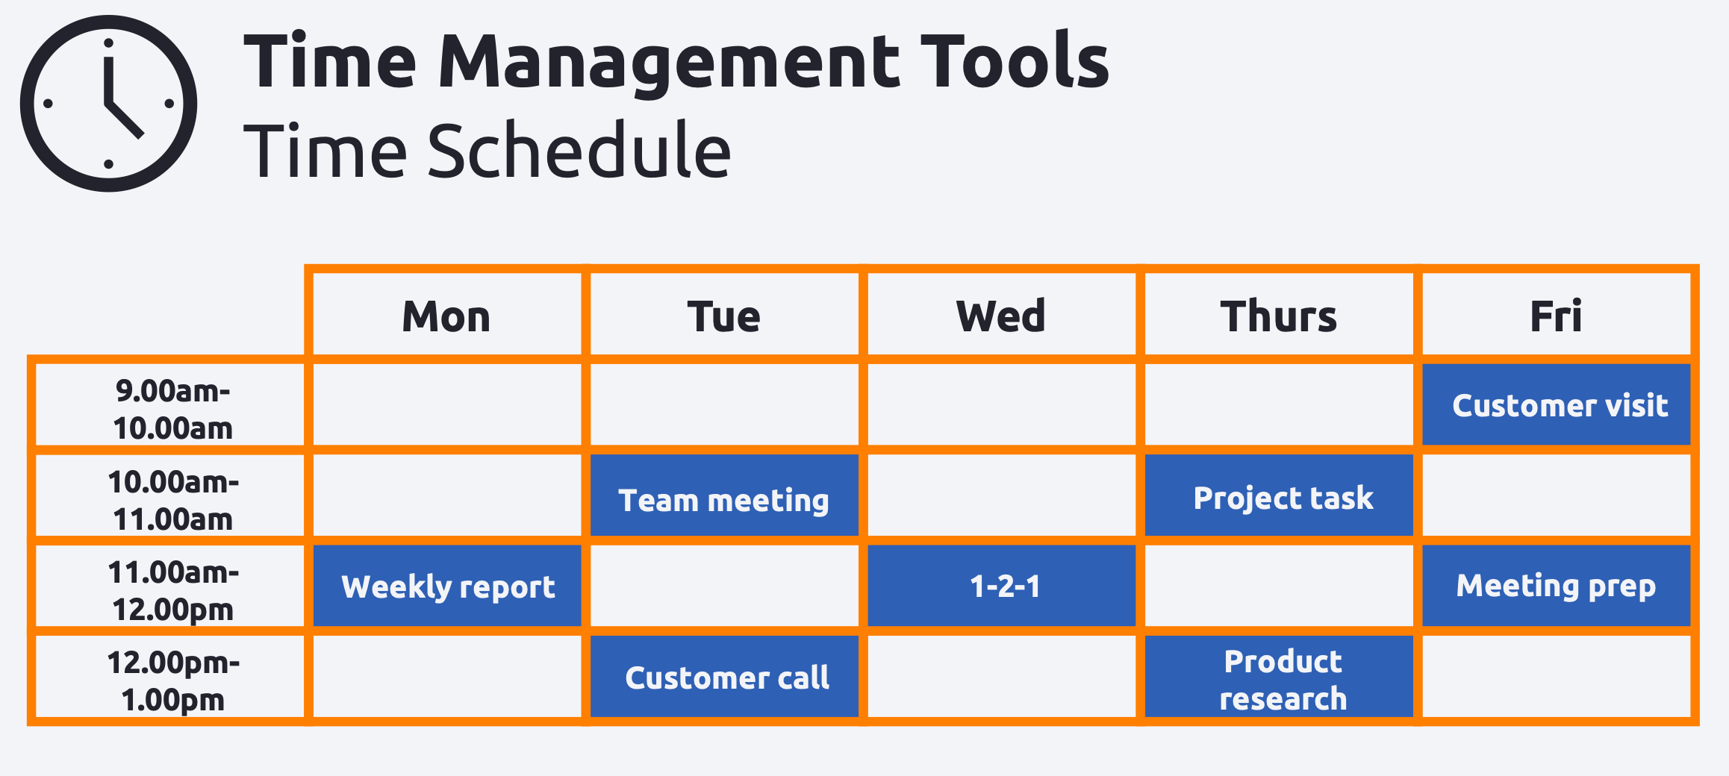
Time Schedule
If a to-do list is a plan, then we need to create a schedule. Creating a time schedule is a highly effective time management tool that will help you to get more done.
Scheduling your time simply means allocating time for every task that you need to complete. In essence, it’s blocking time out in a calendar or planner.
Benefit-You get a really good picture of everything that you have to do and you can see where your gaps are to add in new tasks.
Downside- The downside is setting it up. It can take some time, but once done, it’s just a matter of keeping it updated

Slide 47
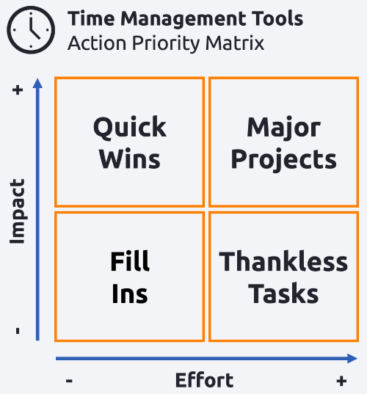
Action/Priority Matrix
The Action/Priority Matrix is a simple to use time management tool that will help with prioritising your tasks. Rather than using the deadline as the driver behind the priority, it uses impact and energy.

Slide 48
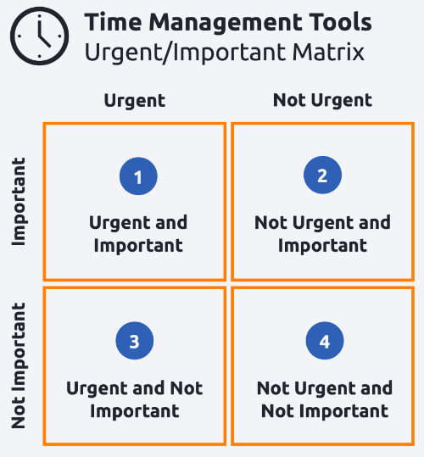
The Urgent/Important Matrix
The Urgent/Important Matrix is probably one of the most common time management tools. It’s a tool used for prioritising tasks.
The original name of this model is the Eisenhower Matrix. The 4 boxes from the Urgent/Important matrix are:
Urgent and Important
Not Urgent and Important
Urgent and Not Important
Not Urgent and Not Important
The grid allows us to either label our tasks as 1 to 4, or place tasks into the relevant box on a grid. The idea being we should deal with box 1 activities first, then box 2, reduce box 3 and eliminate box 4.

Slide 49
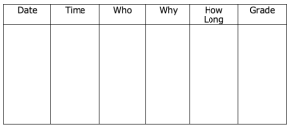
Interruptions Log
Another time management tools is an interruptions log. This simple tool suggests that you spend some time, maybe a week, capturing each time you get interrupted and then analysing the data. This helps you to understand where your time goes and potentially who is stealing it.
Each time you get interrupted (meaning each time you have to stop a task and deal with someone else) fill in the log. Here is how to fill it in:
Date – The date the interruption happened (this could just be written at the start of the day)
Time – The time the interruption happened
Who – Who interrupted you?
Why – Why did they interrupt you?
How long – How long did the interruption last for?
Grade – Grade the interruption to its importance. If the interruption was very necessary, then grade it as A .If the interruption was completely irrelevant, then grade it as D. Mark other interruptions in between.

Slide 50
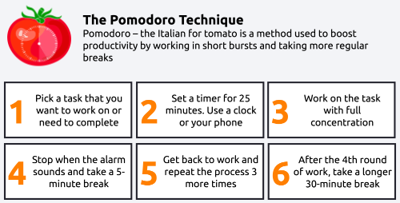
The Pomodoro Technique
The Pomodoro technique encourages the use of more regular breaks and breaking your day up into smaller chunks.
‘The Pomodoro Technique‘ suggests that you break your tasks down into 25-minute sessions known as ‘A Pomodoro‘. Each session is then followed by a short break. After completing 4 tasks like this, take a longer break (such as your scheduled break or lunch) to fully rest.
The Pomodoro Technique developed by Francesco Cirillo in the 1980s. The name Pomodoro was taken from the tomato-shaped kitchen timer.

Slide 51
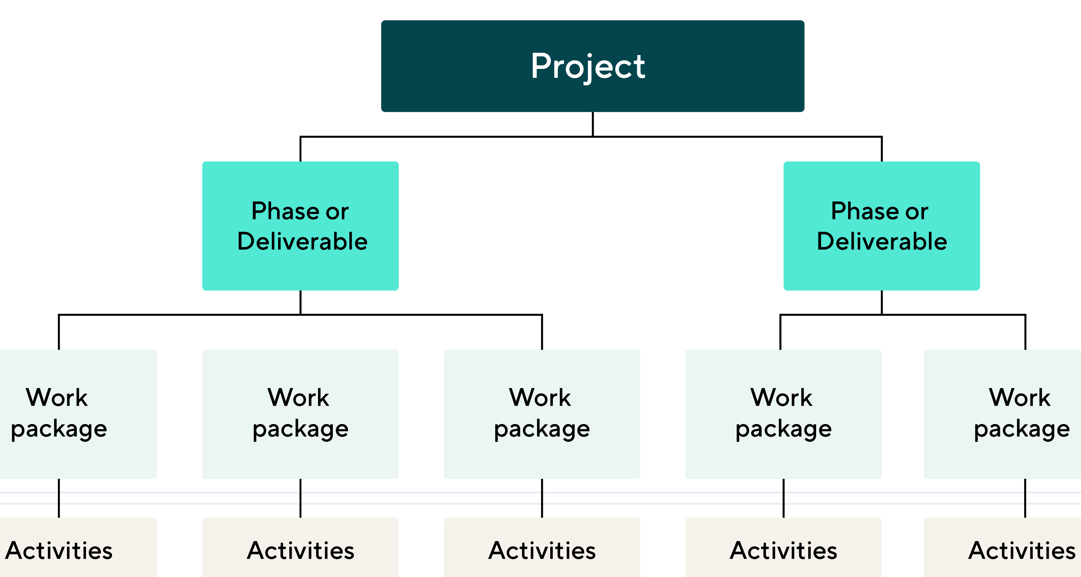
Task Breakdown
This tool suggests that we take the larger tasks that we need to complete and break them down into smaller tasks. The benefits of doing this are huge.
Breaking the bigger tasks into smaller more manageable tasks means they look less overwhelming. We can do one at a time and even spread these out over the course of a day or a week.
The big benefit is, once we get the first task done, we are much more likely to get the second, and then the third done.
When it comes to big tasks, the hard part isn’t getting them finished, it’s getting them started. Making the first task look easy means you are much more likely to keep going.

Slide 52
Online and Digital Tool
Task Managers- Todoist, Microsoft To Do,Things
Focus Timers- Focus Timer app, Forest
Distraction Blockers- DnD mode, Freedom, Cold Turkey Blocker, FocusMe
Time Trackers- alarms, stopwatches,Toggl Track
Calenders- Outlook Calendar, Google Calendar, or Apple Calendar
Habit Trackers- Habitica, HabitGuru, HabitShare
Note Taking- Evernote, OneNote, Notepad++, Notability
Self-Reflection Tools- 5 minute journal app, Focality

Slide 53
Time Management Behavior

Slide 54
Do Time Management Tools help us to manage time or is it something else?
Time management isn’t just about having the right tools.
A big part of time management is behavioural and having the right attitude towards your work and also time itself.
The term Time Management is a misnomer – we can’t actually manage time, but can manage ourselves around the time we have available to us.
How many times have you heard, or used the cry ‘I wish there were more hours in the day? More than once I bet. But, we immerse ourselves in tools to try and manage time but still, sometimes we get nowhere.

Slide 55
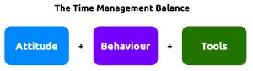
The Right Time Management Attitude and Behaviours
Important is the attitude we show towards time. If we take a negative view of it, it instantly begins to mess up our plans.
he more negative we feel, the less demotivated we are which leads to procrastination and a real lack of drive to get things done. So, aside from the lengthy to-do lists and packed diaries, what else should we do to manage time more effectively?
We need to re-frame thinking towards time.

Slide 56
Readjusting attitudes
Just by changing the name of something re-frames how we think about time. So, calling it me-time or thinking time changes the way we view time and makes us feel different about that time – hopefully, better.
The same goes for saying ‘I never have enough time’. Say it enough and you will believe it. Once that belief sets in, it becomes very de-motivational. Thinking ‘I have lot’s to do, what am I going to do to make the time available’ puts you in a different mindset, one of which you are beginning to commit to making time.
Making more time seems an impossible task when actually it can be quite easy. When was the last time you sat down and looked at how much time you were wasting, or how much of your time other people are taking?
So, don’t just focus on Time Management Tools and hope they will fix all of your problems. Take a step back and consider your attitude towards time. If your attitude is all wrong, then what’s the point in using the tools in the first place?

Slide 57
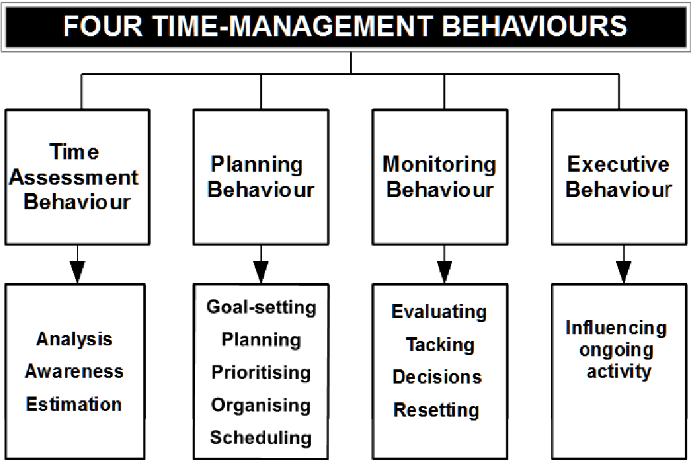

Slide 58
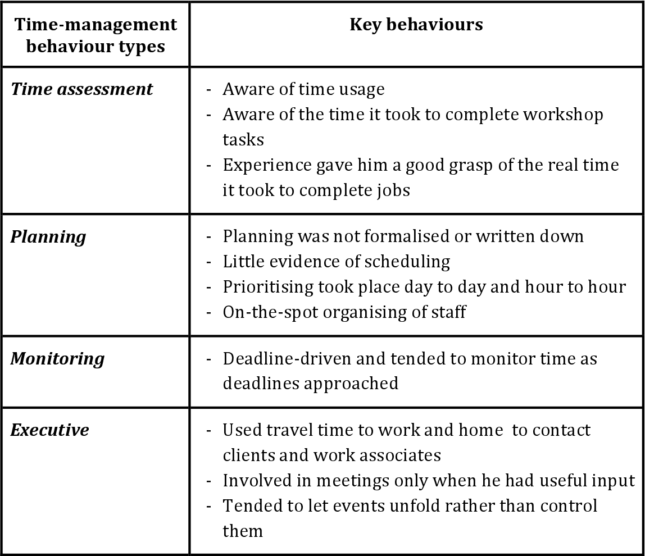
Example
Observations on each time management behaviour type.
Refer: https://www.semanticscholar.org/paper/An-exploration-of-the-time-management-behaviours-of-McNamara/1452c63d6add38630c7c67142c1aaca64392cc0d

